Slide 1
Approval Reminders – Multiple Approval Scenario
Request Description
List has multiple People/Group columns. We need to get approvers from each column [There can be multiple approvers for each column] and send the request for Approval.
If approvers did not Approve the request within 5 days, send reminders to People who have not approved.
Limitation/Issue
We are using Create an Approval and Wait for an approval activity to assign the approval task and Approval Type is “Approve/Reject-Everyone Must Approve”.
Until everyone Approves/Rejects the task, we cannot get the Approver Response. We need to get Approver response as we need to send reminder mails to people who have not approved.
Only way I found to get current Approval response is to use CDS [Common Data Service] actions but they are listed as Premium.
Notes:
Remedy ticket came on 27th

Slide 2
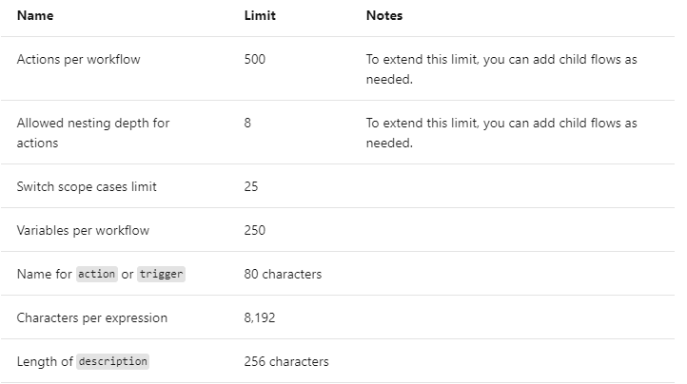
Input Limit – For a Selected Item
  Input Limit is 20
  Make use of PowerApps form to submit data to power Automate

Slide 3
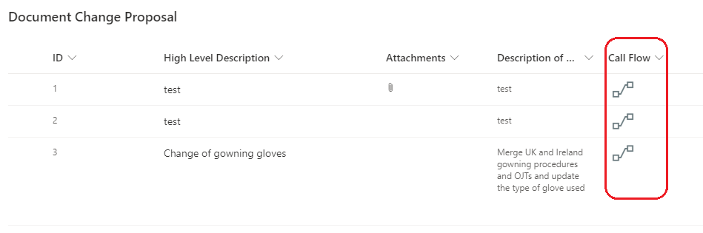
Call Flow using Action Button on List View
Create a Calculated column with Formula =“”
Get the Flow ID
Add Json Formatting on Calculated column [Refer next slide]
Notes:
Remedy ticket came on 27th

Slide 4
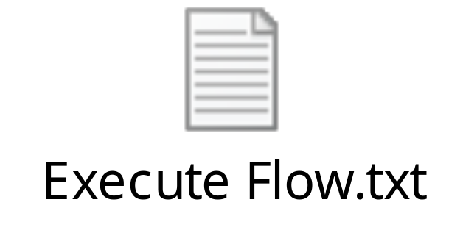
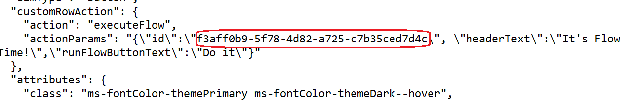
Json Formatting
Copy the code from attached txt file and replace actionParams id with ID of your flow

Slide 5

Use Switch case
If you have more than 5 conditions, use switch case instead of using nested
If-Else condition
Get Todays Date using Expression
Flow Backup & Restore
If an app or a flow is deleted by mistake, then it’s not an easy job to spin it back up without involving Microsoft support.
Export the Flow Package (.Zip File) and keep it as backup
Notes:
Remedy ticket came on 27th

Slide 6
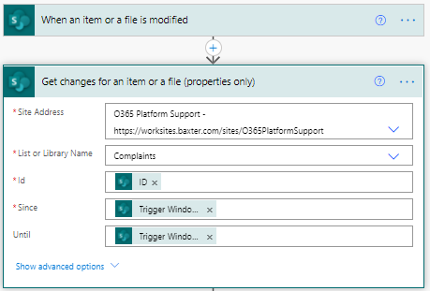
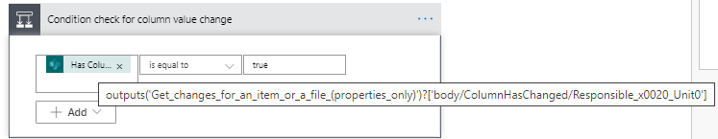
Get Changes for an Item or a File
You can get column data change details on an item or a file using “Get changes for an item or a file” action.
Notes:
Remedy ticket came on 27th

